Slide 1
Comparing Deepfake Detection Between EfficientNet, ViT’s and a CNN ViT Hybrid.
Agustin Munoz, Leo Findley, Danny Kim

Slide 2
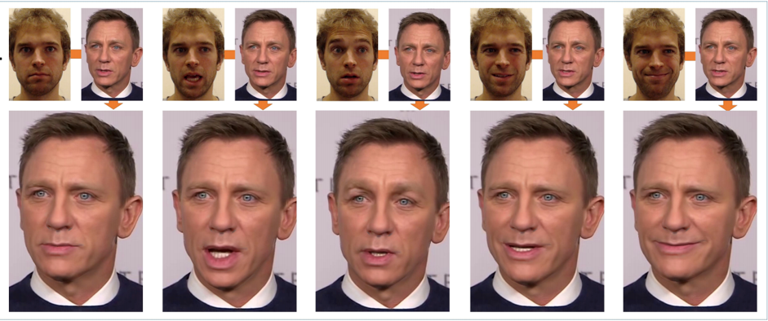
Introduction and Motivation
In recent years deepfake generation techniques have improved in an exponential way, where as a few years ago you had images and videos that looked like weird abominations of the things they were trying to mimic, nowadays deepfakes can sometimes seem almost indistinguishable to the naked eye from what it is trying to copy. Through the usage of technologies like Variational Autoencoders and Generative Adversarial Networks, deepfakes are now able to fool many into believing the generated product to be real, and although this is not an inherently bad technology, as it can be used in things like film to make an actor look younger, older or just different, it can be used in more nefarious ways, like trying to steal someone's likeness or fool people into believing something someone did or said in a deepfake video to be real. This has lead to many developments in the field of detecting deepfakes to be able to better distinguish what is real from fake.

Slide 3
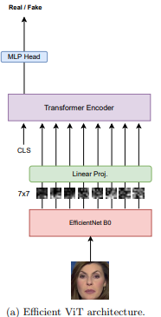
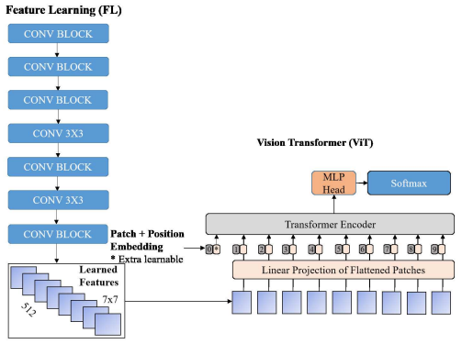
Introduction and Motivation
To combat the wider spread of deepfake usage multiple forms of detecting deepfakes in images, video and even audio have been made. Some of the top AI models used in these methods use CNNs like EfficientNet or Visual Transformers(ViTs), but the paper that inspired our research into this topic proposes the use of a CNN ViT hybrid, where the CNN gets used for feature extraction which then gets sent to a Transformer Encoder, making the setup work similarly to a ViT. This setup offers comparable performance to other CNN and ViT models but uses less parameters and in our case in a substantially shorter amount of time

Slide 4
Problem Statement and Related Work
In the paper Combining EfficientNet and Vision Transformers for Video Deepfake Detection, the authors state how a hybrid model using EfficintNet as a feature extractor and a Transformer Encoder can rival the accuracy and f1 scores of state of the art CNNs and ViTs while using less params on their pretrained weights. For our video and audio models we use a small EfficientNetV2 using ~21 million params, a small ViT using ~22 million params, and a EfficientNetB0 with a tiny ViT for the hybrid using ~9 million params. The models look for inconsistencies in the frames or spectrographs and learn subtle cues like blurry frames and too smooth spectrographs.

Slide 5
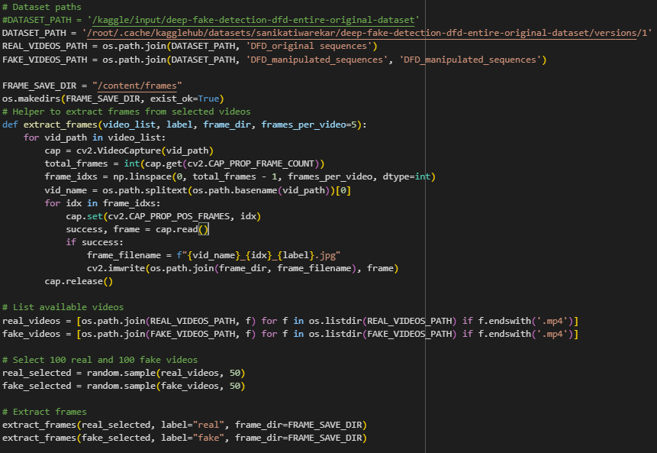

Approach: Video
We first select an randomized but equal amount of real and fake videos from the Deep Fake Detection (DFD) Entire Original Dataset from kaggle which are a dataset of real videos of actors and a dataset of edited video deepfakes. Then we get their frames extracted after which they are resized and transformed to a tensor then we create a dataset of images for training and validation for our models.

Slide 6

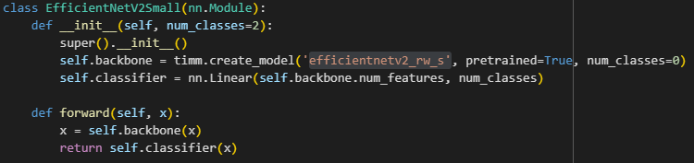
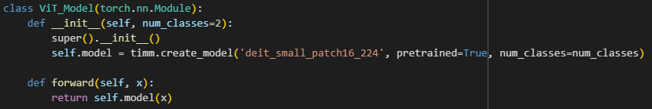
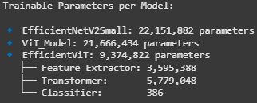
Approach: Video
For the CNN models we used a small version of EfficientNetV2 with pretrained weights, a small ViT with pretrained weights and the hybrid used a combination of EfficientNetB0 which is the smallest of efficient networks and a tiny ViT both of which use less params than their full model counterparts.

Slide 7
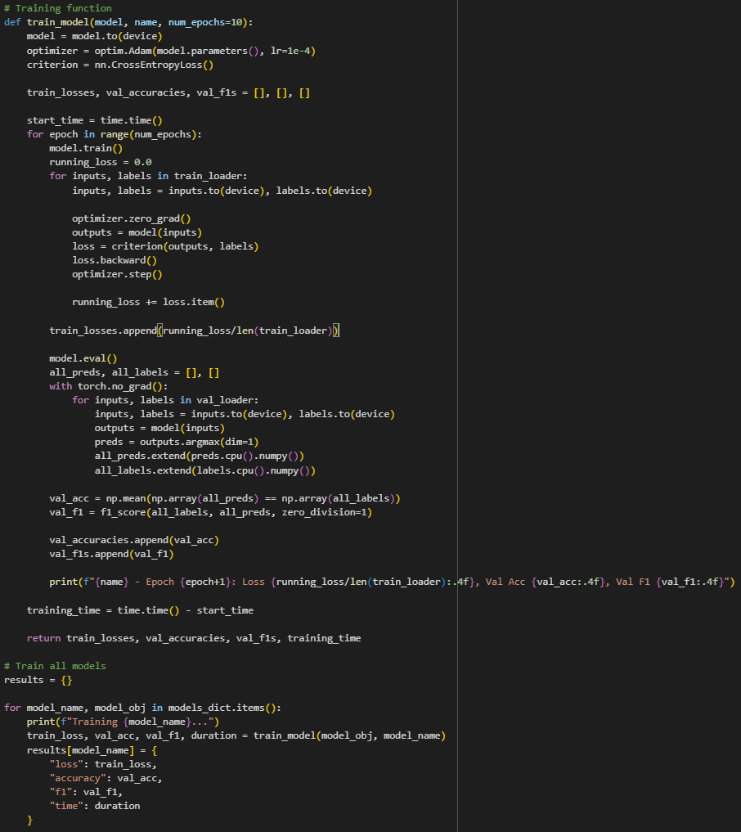
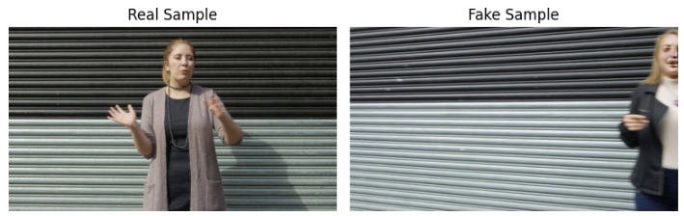
Experiments: Video
From the Deep Fake Detection (DFD) Entire Original Dataset which uses data from the Face Forensics server, using 80% of the data for training and 20% for validation, we trained the models using the Adam optimizer and tested for loss, accuracy and f1 scores over 10 epochs.

Slide 8
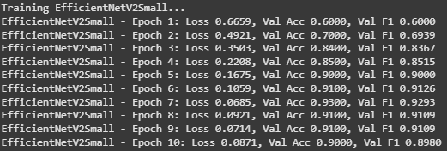
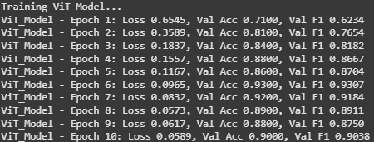
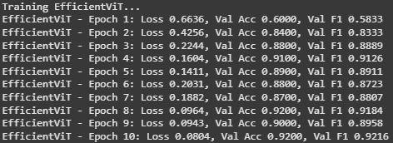
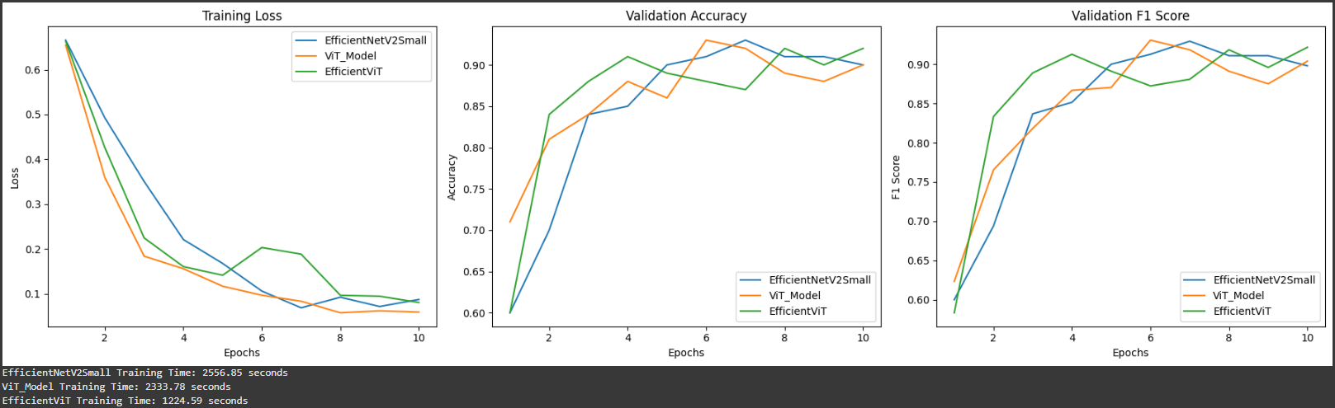
Experiments: Video (50 Real/50 Fake)
Here we see that the Hybrid model more or less matched or outperformed both the CNN and ViT models, this is using less parameters for its pretrained weights and taking less time to complete, which has a substantial reduction in cost of resources needed to run this model compared to the others.

Slide 9
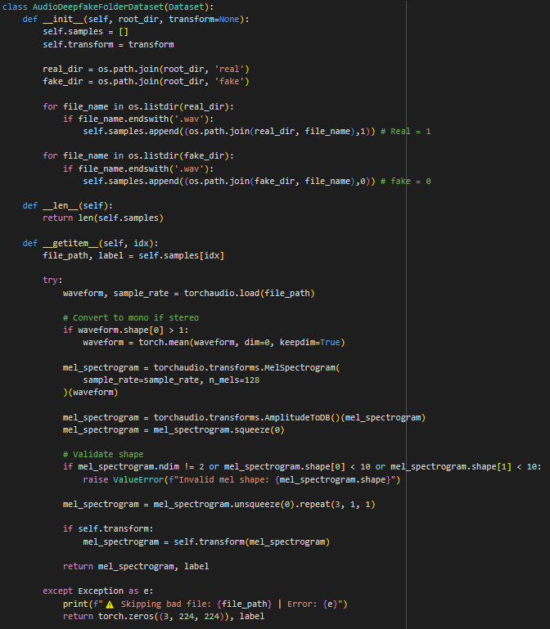
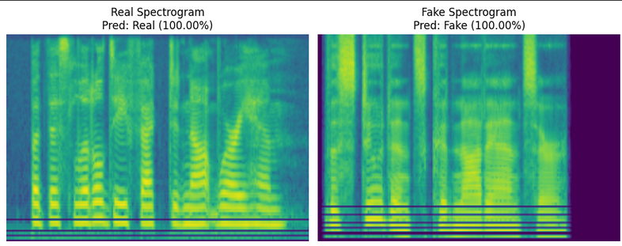
Approach: Audio
Dataset & Preprocessing
Dataset Source
https://www.kaggle.com/datasets/mohammedabdeldayem/the-fake-or-real-dataset?resource=download
Spectrogram Conversion
Load .wav files via torchaudio
Conversion to momo, compute 128-band MelSpectrogram
Convert to dB scale, resize to 224x224, normalize

Slide 10
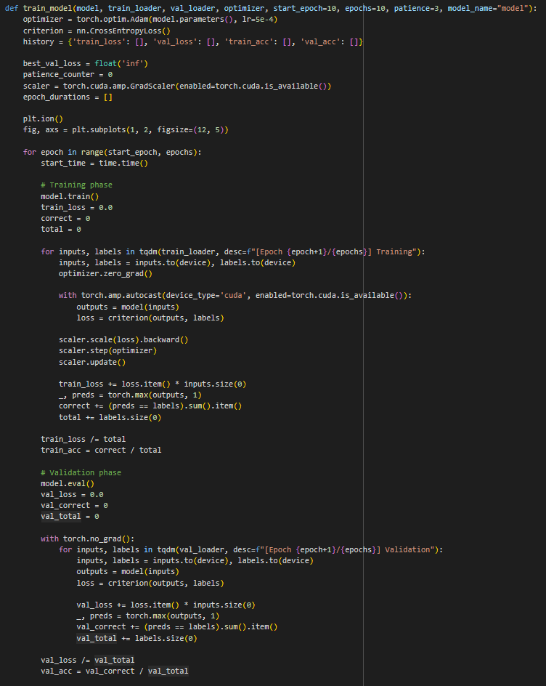
Approach Audio pt2
EfficientNetv2
Architecture and Features
Pretrained EfficientNetV2 (RW-S) backbone
Global average pool, head adapted for 2 classes
Training Setup
Backbone frozen, only classification head trainable
Adam optimizer, CrossEntropyLoss
Vit-Small
Architecture and Features
Pretrained Vision Transformer (Deit-Small Patch16)
Global average pool, head adapted for 2 classes
Training Setup
Backbone frozen, only classification head trainable
Adam optimizer, CrossEntropyLoss

Slide 11
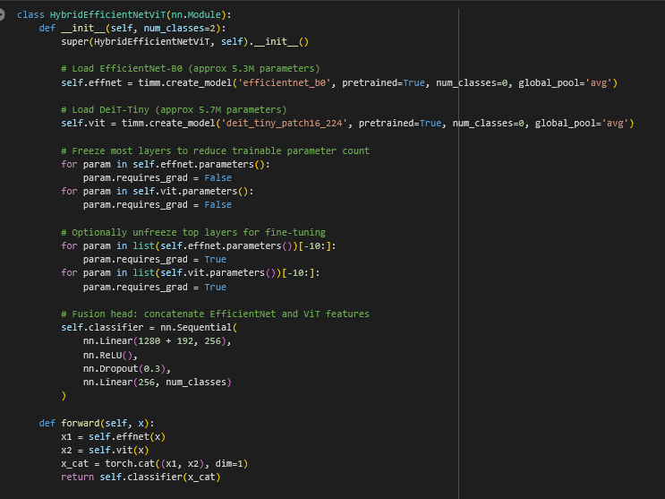
Approach Audio pt 3
Hybrid Model: EfficientNet-B0 and ViT-Tiny
Components and Fusion
EffientNet-B0 backbone(CNN, 1280-dim features)
ViT Tiny(DeiT-Tiny Patch16, 192-dim features
Fusion Head
Concatenate 1280+192 features
Dense (256 units) -> ReLU -> Dropout(0.3) -> Dense(2 classes)

Slide 12
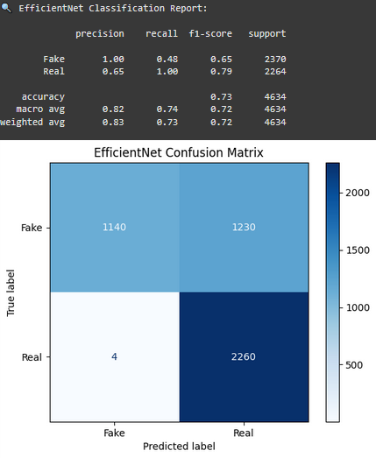
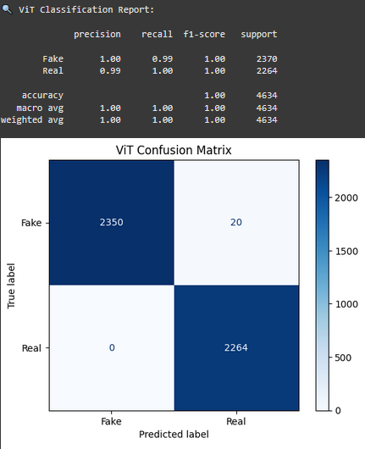
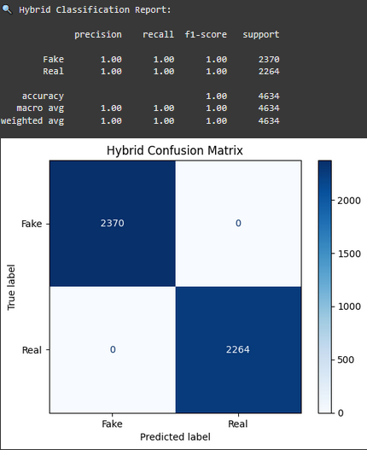
Experiments: Audio
Evaluation Metrics
Accuracy, Precision, Recall, F1-score
Confusion matrix visualization
Training/Validation/Testing

Slide 13
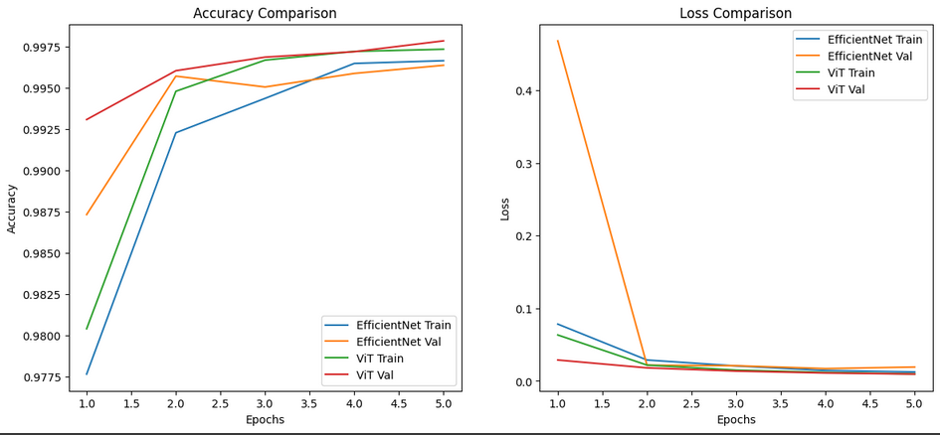
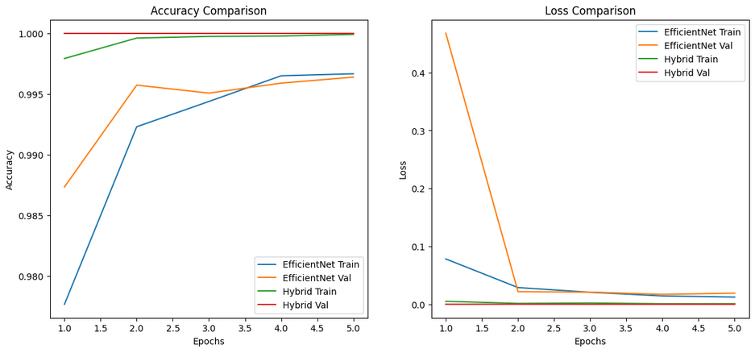
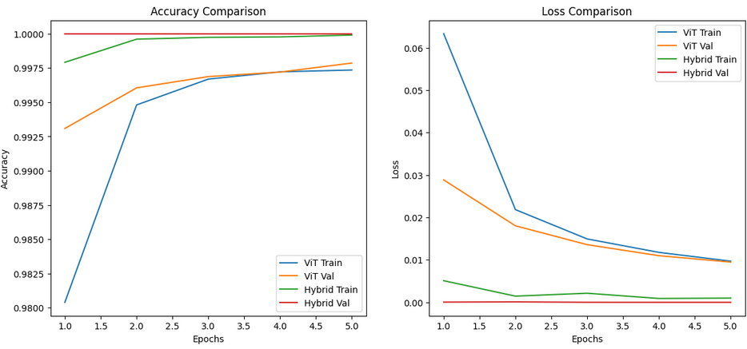

Slide 14
Innovations
Most of the papers we read on the topic of deepfake detection focused mainly on video and image deepfake detection, especially those on the topic of a CNN ViT hybrid. We introduce the idea of using this hybrid not only for video and images but also for audio depfakes giving the hybrid multi modality usage for the comparisons with the CNN and Vit models.

Slide 15
Conclusion(Takeaway)
Hybrid fusion leverages strength of both backbones
Non-hybrid models provide a baseline performance which are met by the hybrid model
Hybrid models require less parameters than non-hybrid models to get similar results
Hybrid model has a better completion time
Further Improvements:
Explore larger/deeper transformer models
Real-Time live detection support such as voice authenticator.
Test how training with more fake than real data and more real than fake data would affect the outcome.
Build efficient models from scratch without using models with pretrained weights.
Team contributions:
Video Models: Agustin Munoz, Leo Findley
Audio Models: Danny Kim

